Slide 1
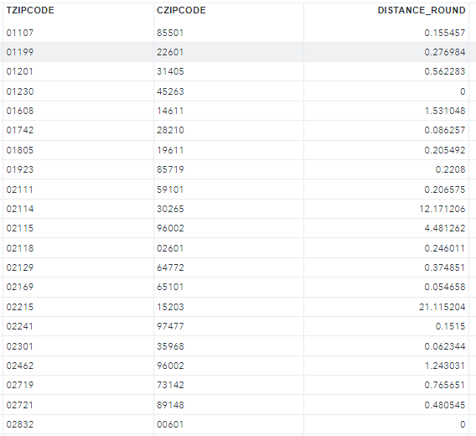
FASTCLUS in SAS
FASTCLUS is SAS procedure used for the clustering analysis. This procedure displays a cluster summary, giving the following for each cluster:
Cluster number, the number of observations in the cluster, maximum distance from seed to observation, the maximum distance from the cluster seed to any observation in the cluster
PROC FASTCLUS
DATA=STDCAND
MAXC=N_TEST
MAXITER=0
OUT=RESULT
SEED=STDTEST;
ODS OUTPUT INITIALSEEDS=INITIAL;
VAR SALES_L6M SALES_L5M SALES_L4M
SALES_L3M SALES_L2M SALES_L1M
CALLS_L6M
MMF_L6M
EM_ENGAGED_L6M
ALERTS_ENGAGED_L6M;
RUN;

Slide 2
REGRESSION
Regression model is run based on the matched test and control pair universe with post sales as dependent variables and post variables as independent variables
PROC REG DATA= DATA OUTEST=OUT_MOD;
MODEL: SALES_POST_12M = SALES_PRE_12M
CALLS_POST_12M MMF_POST_12M EM_ENGAGED_POST_L12M ALERTS_ENGAGED_POST_L12M
TEST_FLAG/VIF;
ID ZIP_CD;
PLOT / RIDGEPLOT NOMODEL NOSTAT;
ODS OUTPUT OUTPUTSTATISTICS=OUTSTATS;
RUN;
Impact (%) – Estimate * # Tests*12 /Total 12 Month Sales

